Slide 1
Expectation and Variance of a Random Variable

Slide 2
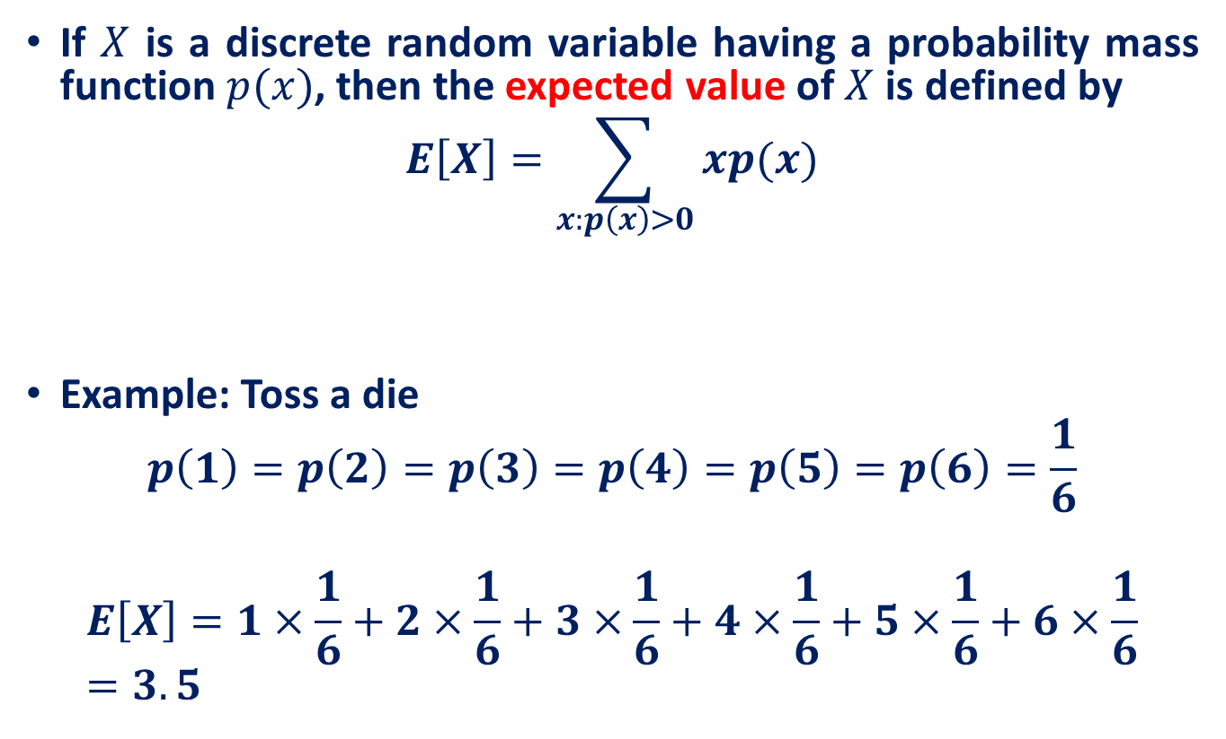
Recall: The Discrete Case
If $X$ is a discrete random variable having a probability mass function $p(x)$, then the expected value of $X$ is defined by
$$E\left[X\right]=\sum_{x:p\left(x\right)>0}{xp(x)}$$
Example: Toss a die
$$p\left(1\right)=p\left(2\right)=p\left(3\right)=p\left(4\right)=p\left(5\right)=p\left(6\right)=\frac{1}{6}$$
$$E\left[X\right]=1×\frac{1}{6}+2×\frac{1}{6}+3×\frac{1}{6}+4×\frac{1}{6}+5×\frac{1}{6}+6×\frac{1}{6}=3.5$$
The expected value of X is a weighted average of the possible values that X can take on; each value being weighted by the probability that X assumes that value.

Slide 3
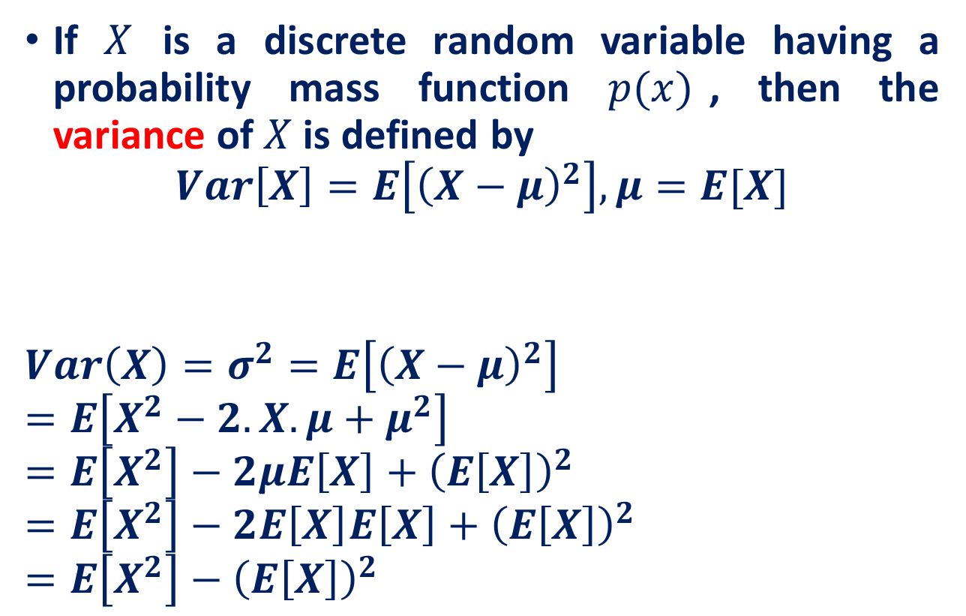
Recall: The Discrete Case
If $X$ is a discrete random variable having a probability mass function $p(x)$, then the variance of $X$ is defined by
$$Var\left[X\right]=E\left[{\left(X−μ\right)}^{2}\right], μ=E[X]$$
$$Var\left(X\right)=σ^{2}=E\left[{\left(X−μ\right)}^{2}\right]=E\left[X^{2}−2.X.μ+μ^{2}\right]$$
$$=E\left[X^{2}\right]−2μE\left[X\right]+{\left(E\left[X\right]\right)}^{2}$$
$$=E\left[X^{2}\right]−2E\left[X\right]E\left[X\right]+{\left(E\left[X\right]\right)}^{2}$$
$$=E\left[X^{2}\right]−{\left(E\left[X\right]\right)}^{2}$$
The variance of X measures the expected square of the deviation of X from its expected value.

Slide 4
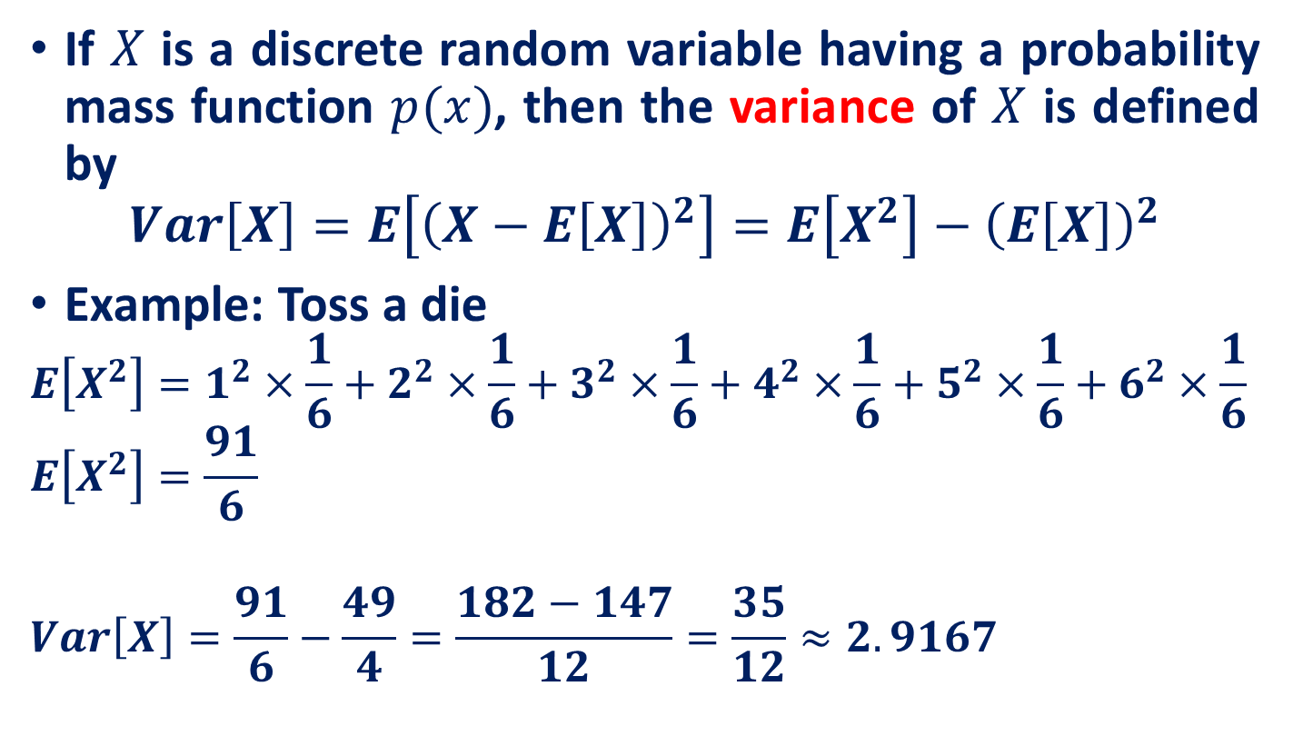
Recall: The Discrete Case
If $X$ is a discrete random variable having a probability mass function $p(x)$, then the variance of $X$ is defined by
$$Var\left[X\right]=E\left[{\left(X−E\left[X\right]\right)}^{2}\right]=E\left[X^{2}\right]−{\left(E\left[X\right]\right)}^{2}$$
Example: Toss a die
$$E\left[X^{2}\right]=1^{2}×\frac{1}{6}+2^{2}×\frac{1}{6}+3^{2}×\frac{1}{6}+4^{2}×\frac{1}{6}+5^{2}×\frac{1}{6}+6^{2}×\frac{1}{6}$$
$$E\left[X^{2}\right]=\frac{91}{6}$$
$$Var\left[X\right]=\frac{91}{6}−\frac{49}{4}=\frac{182−147}{12}=\frac{35}{12}≈2.9167$$

Slide 5
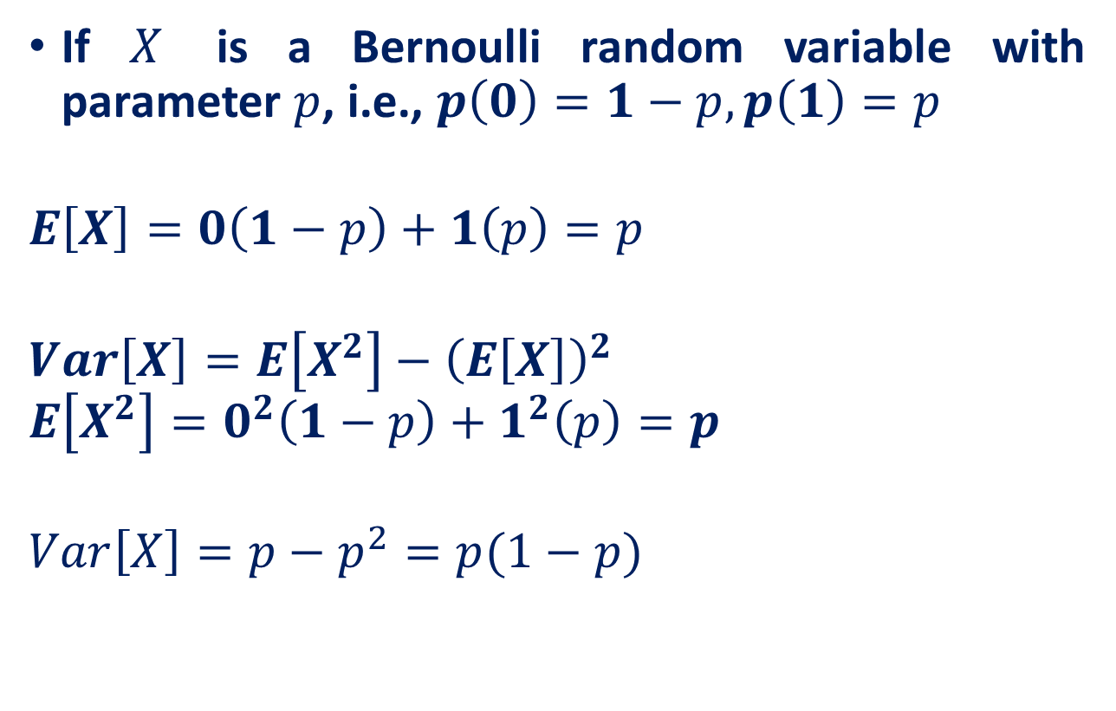
Recall: Bernoulli Random Variable
If $X$ is a Bernoulli random variable with parameter $p$, i.e., $p\left(0\right)=1−p, p\left(1\right)=p$
$$E\left[X\right]=0\left(1−p\right)+1\left(p\right)=p$$
$$Var\left[X\right]=E\left[X^{2}\right]−{\left(E\left[X\right]\right)}^{2}$$
$$E\left[X^{2}\right]=0^{2}\left(1−p\right)+1^{2}\left(p\right)=p$$
$$Var\left[X\right]=p−p^{2}=p(1−p)$$

Slide 6
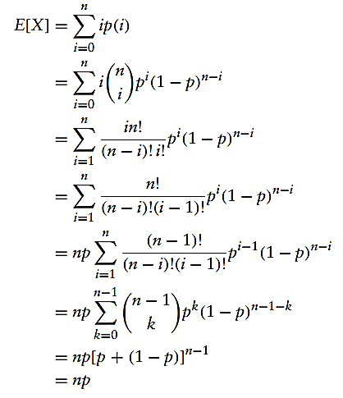

Recall: Binomial Random Variable
If X is binomially distributed with parameters $n$ and $p$
$Var\left(X\right)=np(1−p)$ [Proof Next Slide]
Refer slides on Discrete random variables posted earlier

Slide 7
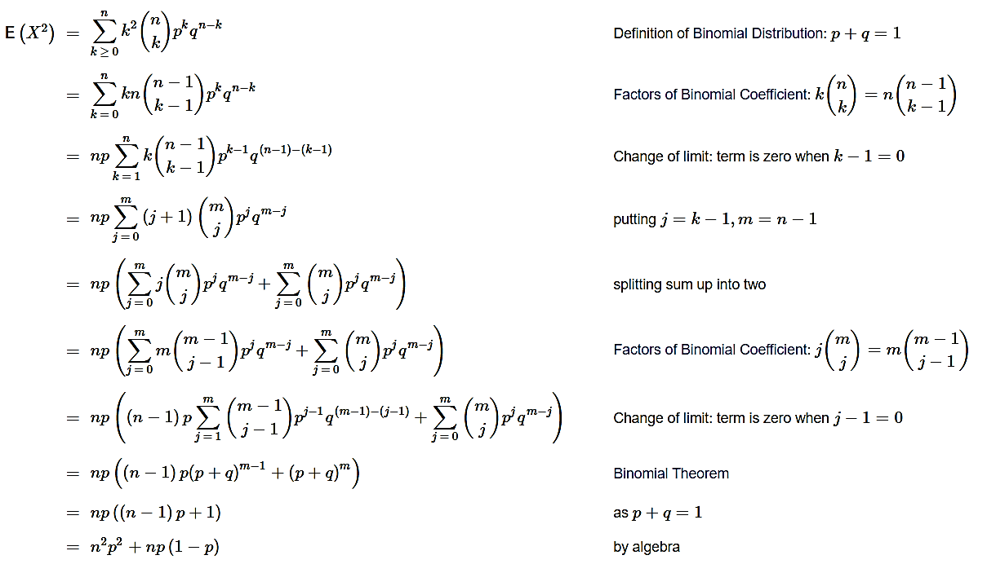
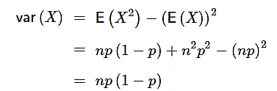
Recall: Variance of a Binomial Random Variable

Slide 8
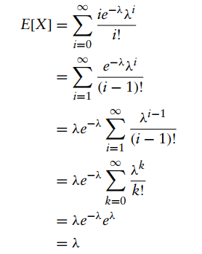

Recall: Poisson Distribution
If X is Poisson random variable with parameters $λ$
Refer slides on Discrete random variables posted earlier

Slide 9

Recall: Poisson Distribution
$Var\left(X\right)=λ$
$$E\left[X^{2}\right]=E\left[X\left(X−1\right)+X\right]=E\left[X\left(X−1\right)\right]+λ$$
$$E\left[X\left(X−1\right)\right]=\sum_{x=0}^{∞}{(x)(x−1)e^{−λ}\frac{λ^{x}}{x!}}$$

Slide 10
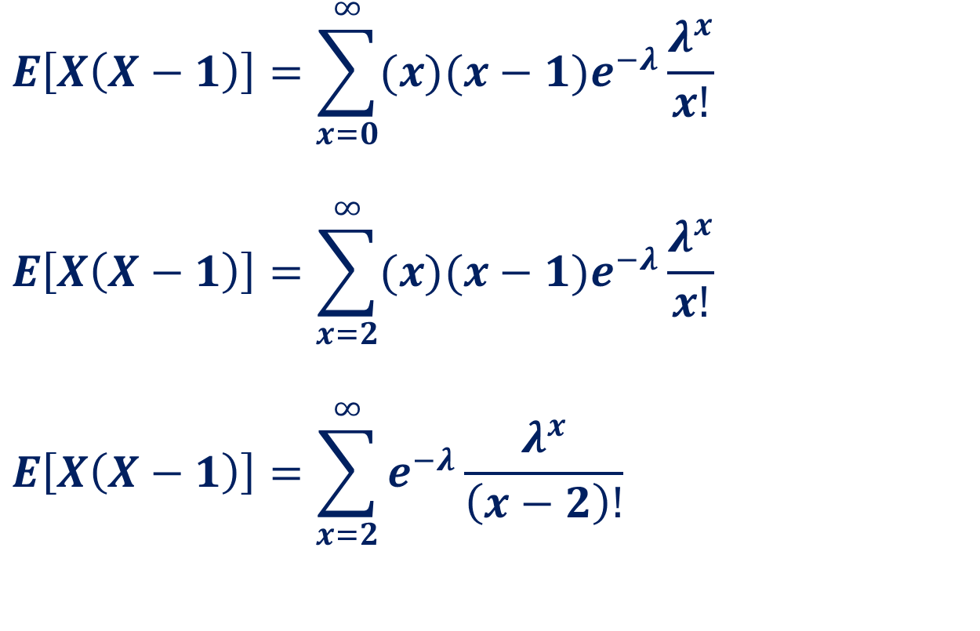
Recall: Poisson Distribution
$$E\left[X\left(X−1\right)\right]=\sum_{x=0}^{∞}{(x)(x−1)e^{−λ}\frac{λ^{x}}{x!}}$$
$$E\left[X\left(X−1\right)\right]=\sum_{x=2}^{∞}{(x)(x−1)e^{−λ}\frac{λ^{x}}{x!}}$$
$$E\left[X\left(X−1\right)\right]=\sum_{x=2}^{∞}{e^{−λ}\frac{λ^{x}}{\left(x−2\right)!}}$$

Slide 11
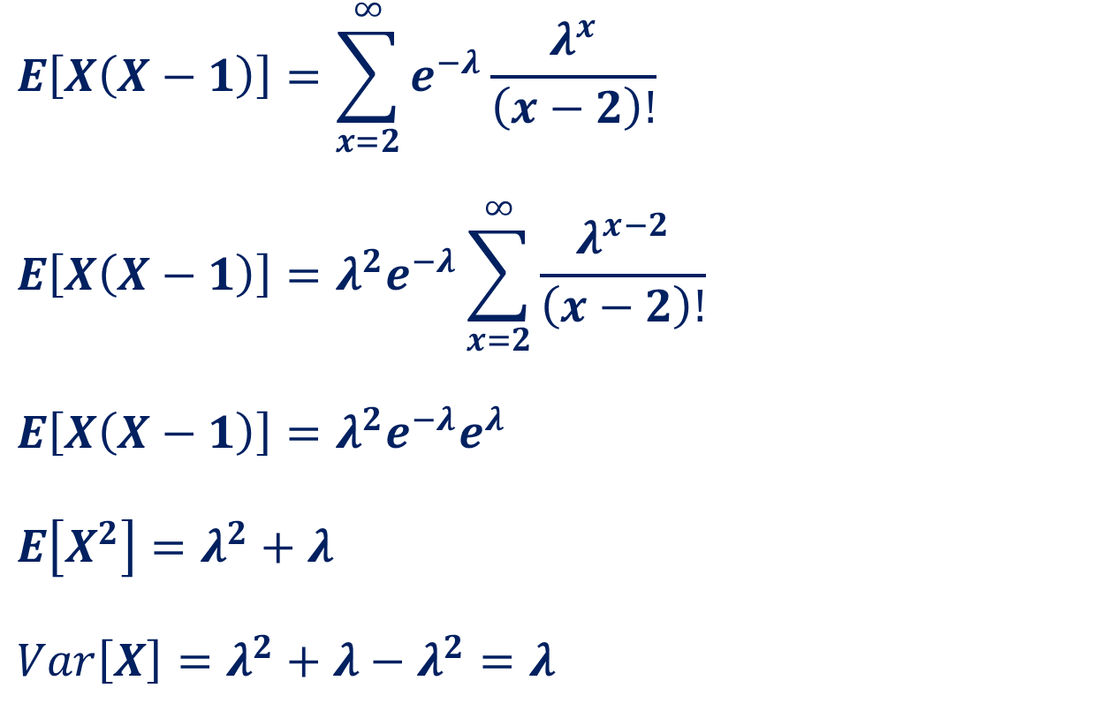
Recall: Poisson Distribution
$$E\left[X\left(X−1\right)\right]=\sum_{x=2}^{∞}{e^{−λ}\frac{λ^{x}}{\left(x−2\right)!}}$$
$$E\left[X\left(X−1\right)\right]=λ^{2}e^{−λ}\sum_{x=2}^{∞}{\frac{λ^{x−2}}{\left(x−2\right)!}}$$
$$E\left[X\left(X−1\right)\right]=λ^{2}e^{−λ}e^{λ}$$
$$E\left[X^{2}\right]=λ^{2}+λ$$
$$Var\left[X\right]=λ^{2}+λ−λ^{2}=λ$$

Slide 12
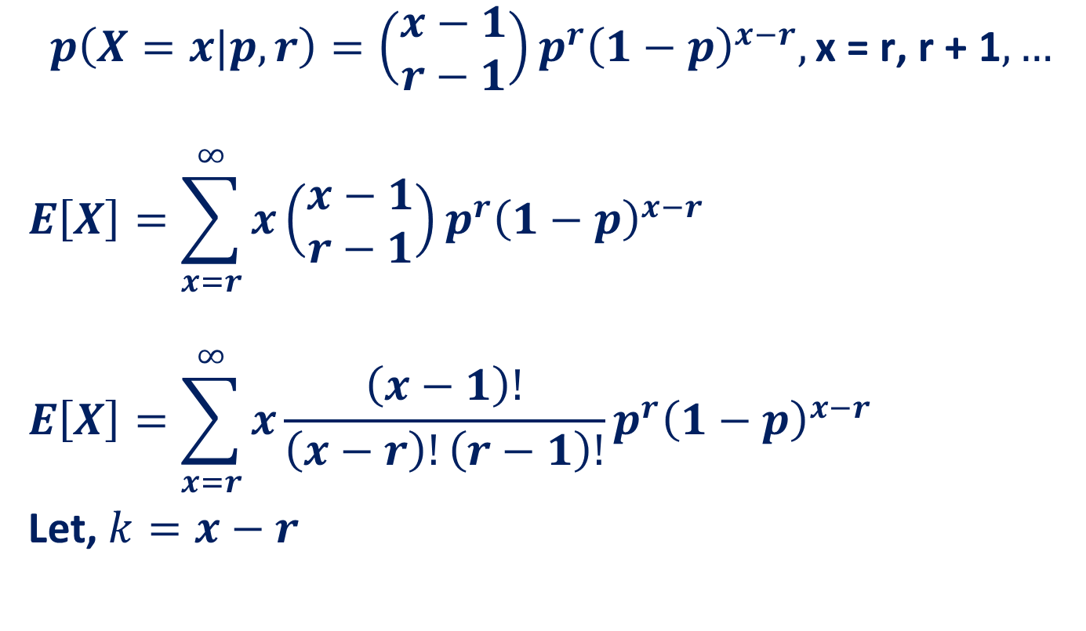
Recall: Negative Binomial Random Variable
$$p\left(X=x|p,r\right)=\left(\begin{aligned}x−1 \\ r−1\end{aligned}\right)p^{r}{\left(1−p\right)}^{x−r},\text{x}\text{ = }\text{r}\text{, }\text{r}\text{ + 1},…$$
$$E\left[X\right]=\sum_{x=r}^{∞}{x\left(\begin{aligned}x−1 \\ r−1\end{aligned}\right)p^{r}{\left(1−p\right)}^{x−r}}$$
$$E\left[X\right]=\sum_{x=r}^{∞}{x\frac{\left(x−1\right)!}{\left(x−r\right)!\left(r−1\right)!}p^{r}{\left(1−p\right)}^{x−r}}$$
Let, $k=x−r$

Slide 13

Recall: Negative Binomial Random Variable
$$E\left[X\right]=\sum_{x=r}^{∞}{\frac{x!}{\left(x−r\right)!\left(r−1\right)!}p^{r}{\left(1−p\right)}^{x−r}}$$
Let, $k=x−r$
$$E\left[X\right]=\sum_{k=0}^{∞}{\frac{\left(k+r\right)!}{k!\left(r−1\right)!}p^{r}{\left(1−p\right)}^{k}}$$

Slide 14

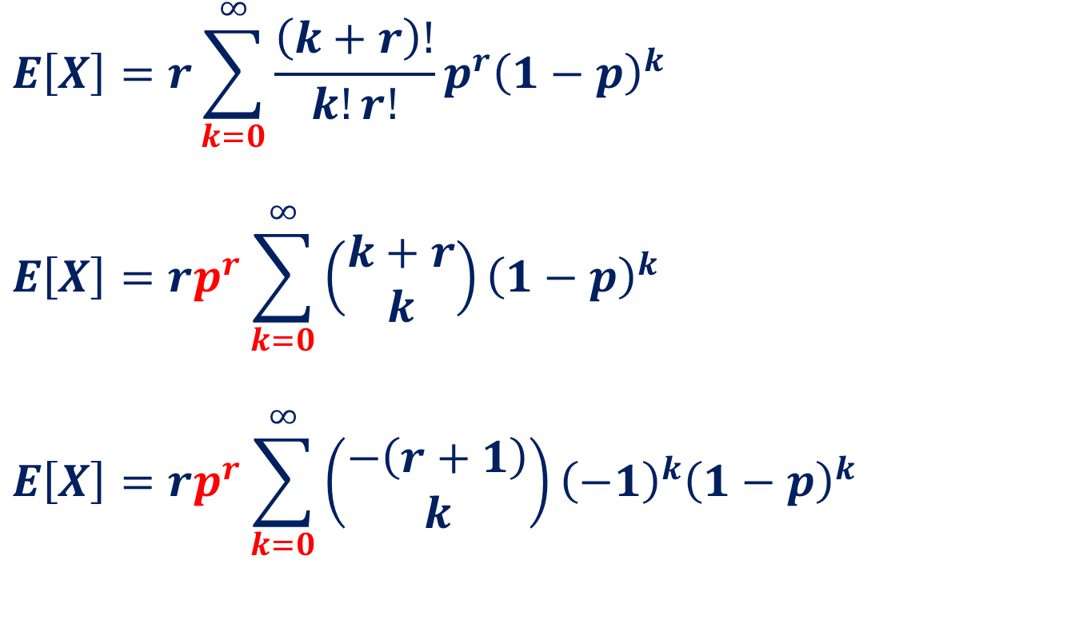
Recall: Negative Binomial Random Variable
$$E\left[X\right]=r\sum_{k=0}^{∞}{\frac{\left(k+r\right)!}{k!r!}p^{r}{\left(1−p\right)}^{k}}$$
$$E\left[X\right]=rp^{r}\sum_{k=0}^{∞}{\left(\begin{aligned}k+r \\ k\end{aligned}\right){\left(1−p\right)}^{k}}$$
$$E\left[X\right]=rp^{r}\sum_{k=0}^{∞}{\left(\begin{aligned}−\left(r+1\right) \\ k\end{aligned}\right){\left(−1\right)}^{k}{\left(1−p\right)}^{k}}$$

Slide 15


Recall: Negative Binomial Random Variable
$$E\left[X\right]=rp^{r}\sum_{k=0}^{∞}{\left(\begin{aligned}−\left(r+1\right) \\ k\end{aligned}\right){\left(−1\right)}^{k}{\left(1−p\right)}^{k}}$$
$$E\left[X\right]=rp^{r}{\left(1−\left(1−p\right)\right)}^{−(r+1)}$$
$$E\left[X\right]=rp^{r}{\left(p\right)}^{−(r+1)}=\frac{r}{p}$$
$$Var\left[X\right]=\frac{r\left(1−p\right)}{p^{2}}$$

Slide 16
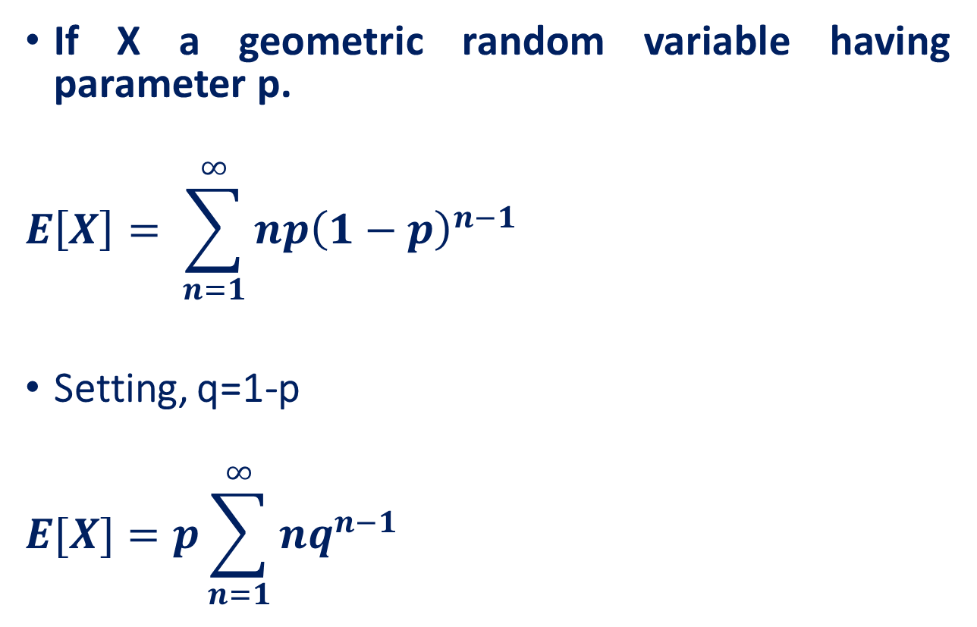
Recall: Geometric Random Variable
If X a geometric random variable having parameter p.
$$E\left[X\right]= \sum_{n=1}^{∞}{np{\left(1−p\right)}^{n−1}}$$
Setting, q=1-p
$$E[X]=p\sum_{n=1}^{∞}{nq^{n−1}}$$

Slide 17

Recall: Geometric Random Variable
$$E\left[X\right]=p\sum_{n=1}^{∞}{nq^{n−1}}$$
$$E[X]=p\sum_{n=1}^{∞}{\frac{d}{dq}q^{n}}$$
$$E[X]=p\frac{d}{dq}\left(\sum_{n=1}^{∞}{q^{n}}\right)$$

Slide 18
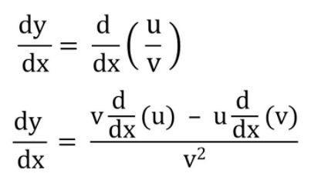
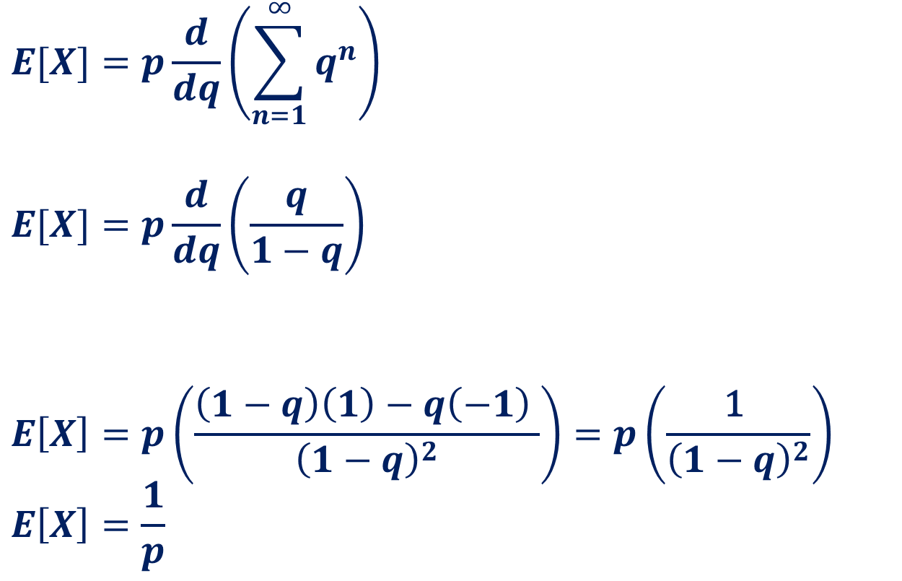

Recall: Geometric Random Variable
$$E[X]=p\frac{d}{dq}\left(\sum_{n=1}^{∞}{q^{n}}\right)$$
$$E[X]=p\frac{d}{dq}\left(\frac{q}{1−q}\right)$$
$$E\left[X\right]=p\left(\frac{\left(1−q\right)\left(1\right)−q\left(−1\right) }{{\left(1−q\right)}^{2}}\right)=p\left(\frac{\text{1} }{{\left(1−q\right)}^{2}}\right)$$
$$E\left[X\right]=\frac{1}{p}$$
$$Var\left[X\right]=\frac{1−p}{p^{2}}$$

Slide 19
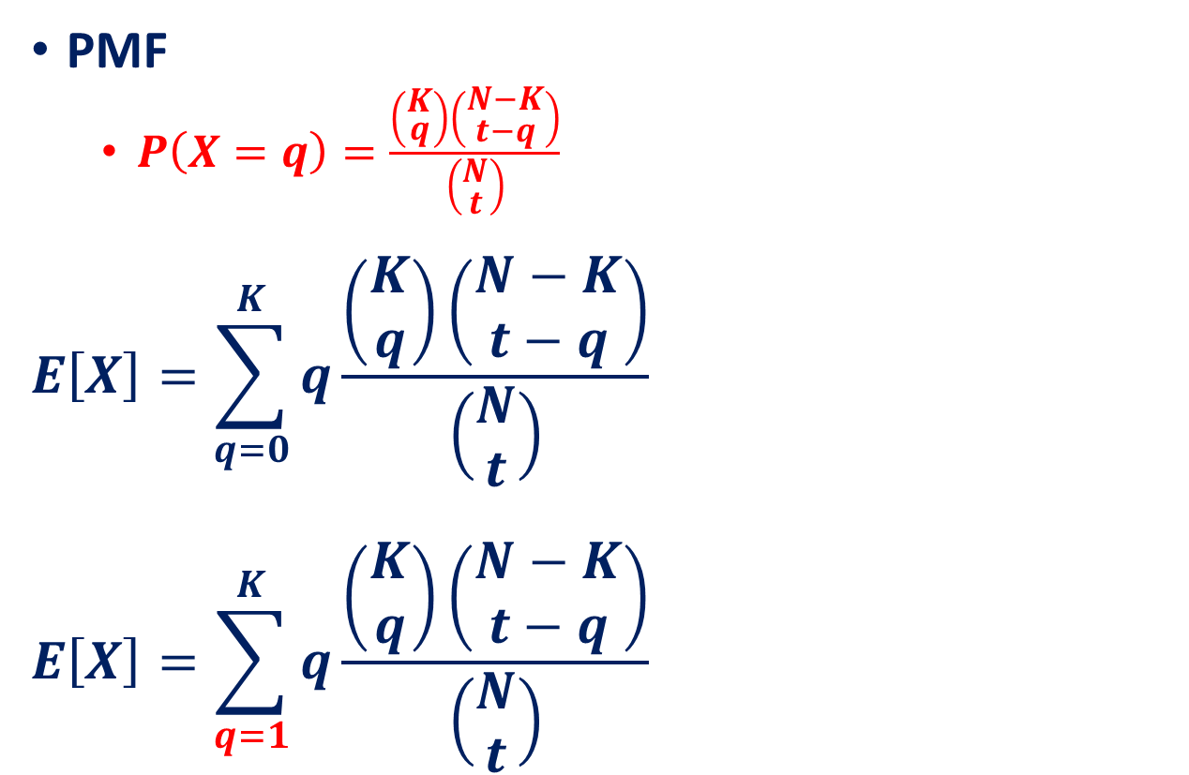
Recall: Expectation of a Hypergeometric Random Variable
PMF
$P\left(X=q\right)=\frac{\left(\begin{aligned}K \\ q\end{aligned}\right)\left(\begin{aligned}N−K \\ t−q\end{aligned}\right)}{\left(\begin{aligned}N \\ t\end{aligned}\right)}$
$$E\left[X\right]=\sum_{q=0}^{K}{q\frac{\left(\begin{aligned}K \\ q\end{aligned}\right)\left(\begin{aligned}N−K \\ t−q\end{aligned}\right)}{\left(\begin{aligned}N \\ t\end{aligned}\right)}}$$
$$E\left[X\right]=\sum_{q=1}^{K}{q\frac{\left(\begin{aligned}K \\ q\end{aligned}\right)\left(\begin{aligned}N−K \\ t−q\end{aligned}\right)}{\left(\begin{aligned}N \\ t\end{aligned}\right)}}$$

Slide 20
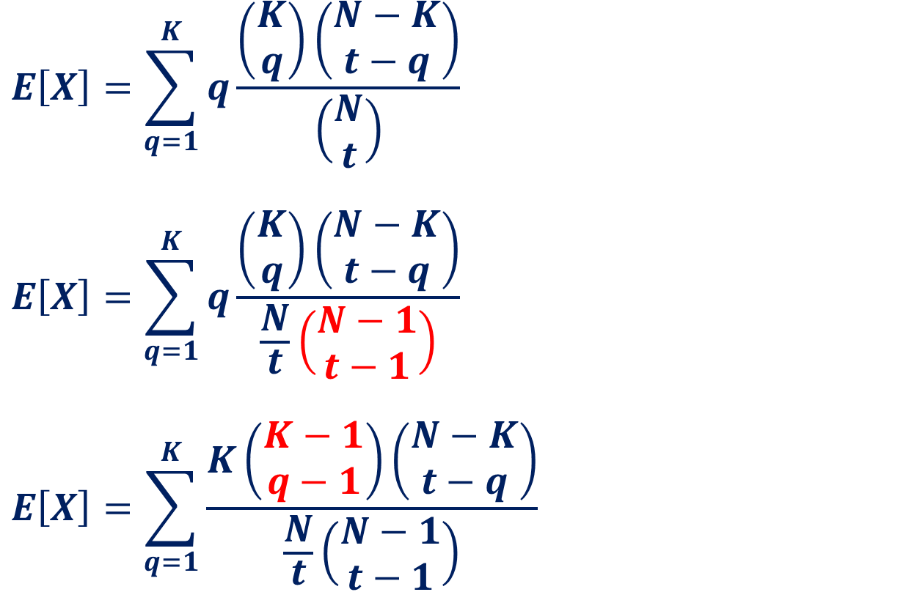
Recall: Expectation of a Hypergeometric Random Variable
$$E\left[X\right]=\sum_{q=1}^{K}{q\frac{\left(\begin{aligned}K \\ q\end{aligned}\right)\left(\begin{aligned}N−K \\ t−q\end{aligned}\right)}{\left(\begin{aligned}N \\ t\end{aligned}\right)}}$$
$$E\left[X\right]=\sum_{q=1}^{K}{q\frac{\left(\begin{aligned}K \\ q\end{aligned}\right)\left(\begin{aligned}N−K \\ t−q\end{aligned}\right)}{\frac{N}{t}\left(\begin{aligned}N−1 \\ t−1\end{aligned}\right)}}$$
$$E\left[X\right]=\sum_{q=1}^{K}{\frac{K\left(\begin{aligned}K−1 \\ q−1\end{aligned}\right)\left(\begin{aligned}N−K \\ t−q\end{aligned}\right)}{\frac{N}{t}\left(\begin{aligned}N−1 \\ t−1\end{aligned}\right)}}$$

Slide 21
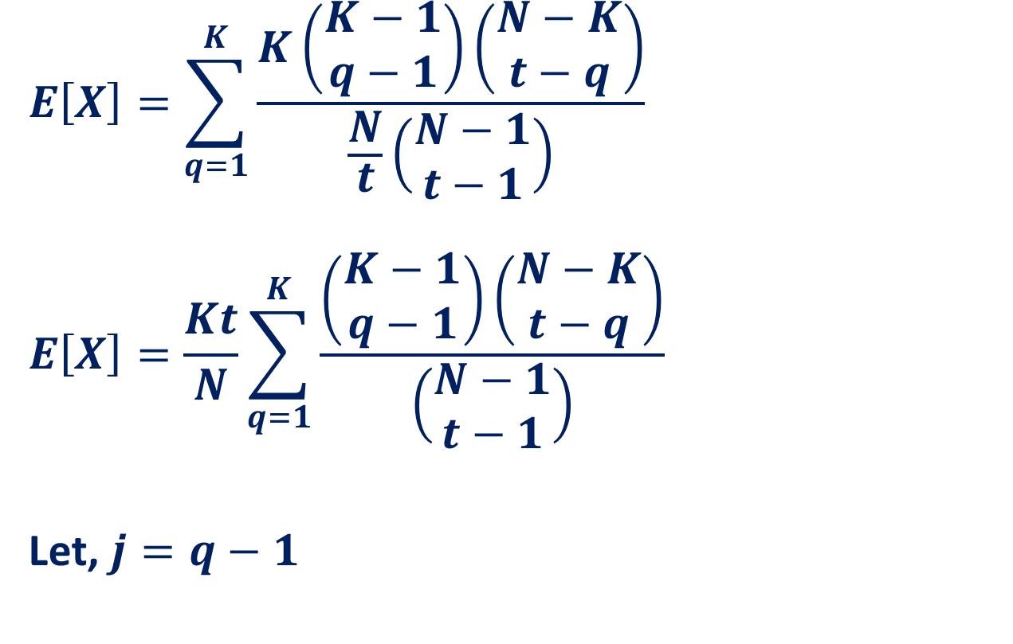
Recall: Expectation of a Hypergeometric Random Variable
$$E\left[X\right]=\sum_{q=1}^{K}{\frac{K\left(\begin{aligned}K−1 \\ q−1\end{aligned}\right)\left(\begin{aligned}N−K \\ t−q\end{aligned}\right)}{\frac{N}{t}\left(\begin{aligned}N−1 \\ t−1\end{aligned}\right)}}$$
$$E\left[X\right]=\frac{Kt}{N}\sum_{q=1}^{K}{\frac{\left(\begin{aligned}K−1 \\ q−1\end{aligned}\right)\left(\begin{aligned}N−K \\ t−q\end{aligned}\right)}{\left(\begin{aligned}N−1 \\ t−1\end{aligned}\right)}}$$
Let, $j=q−1$

Slide 22
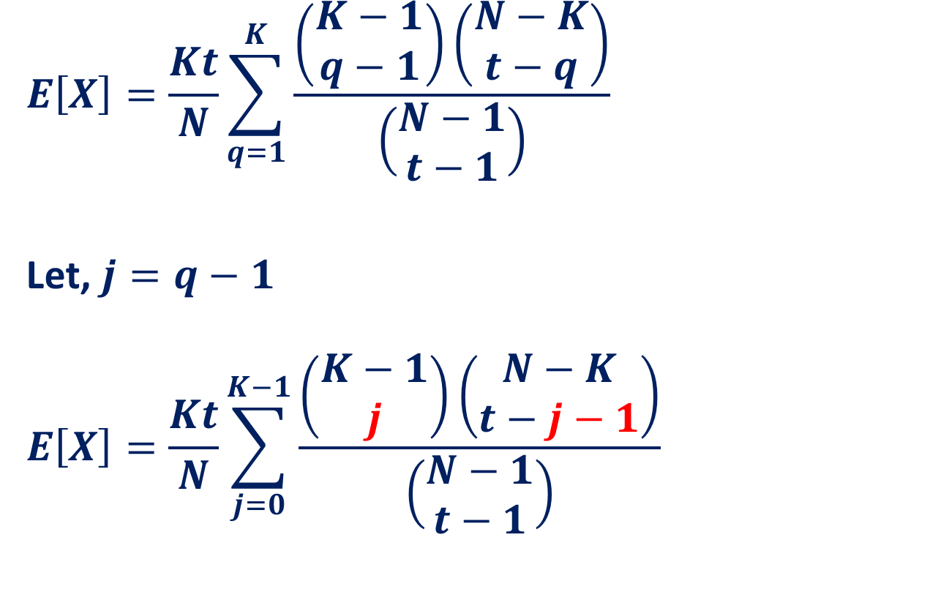
Recall: Expectation of a Hypergeometric Random Variable
$$E\left[X\right]=\frac{Kt}{N}\sum_{q=1}^{K}{\frac{\left(\begin{aligned}K−1 \\ q−1\end{aligned}\right)\left(\begin{aligned}N−K \\ t−q\end{aligned}\right)}{\left(\begin{aligned}N−1 \\ t−1\end{aligned}\right)}}$$
Let, $j=q−1$
$$E\left[X\right]=\frac{Kt}{N}\sum_{j=0}^{K−1}{\frac{\left(\begin{aligned}K−1 \\ j\end{aligned}\right)\left(\begin{aligned}N−K \\ t−j−1\end{aligned}\right)}{\left(\begin{aligned}N−1 \\ t−1\end{aligned}\right)}}$$

Slide 23
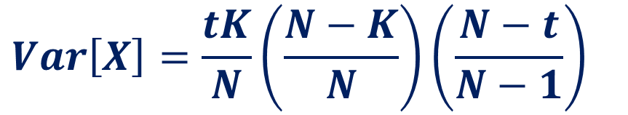

Recall: Expectation of a Hypergeometric Random Variable
$$E\left[X\right]=\frac{Kt}{N}\sum_{j=0}^{K−1}{\frac{\left(\begin{aligned}K−1 \\ j\end{aligned}\right)\left(\begin{aligned}N−K \\ t−j−1\end{aligned}\right)}{\left(\begin{aligned}N−1 \\ t−1\end{aligned}\right)}}$$
$$E\left[X\right]=\frac{Kt}{N}$$
Probability that when you draw t−1 balls from an urn that contains K−1 red and N-k white, you will get exactly j red balls.
1
$$Var\left[X\right]=\frac{tK}{N}\left(\frac{N−K}{N}\right)\left(\frac{N−t}{N−1}\right)$$

Slide 24
Continuous Random Variable

Slide 25
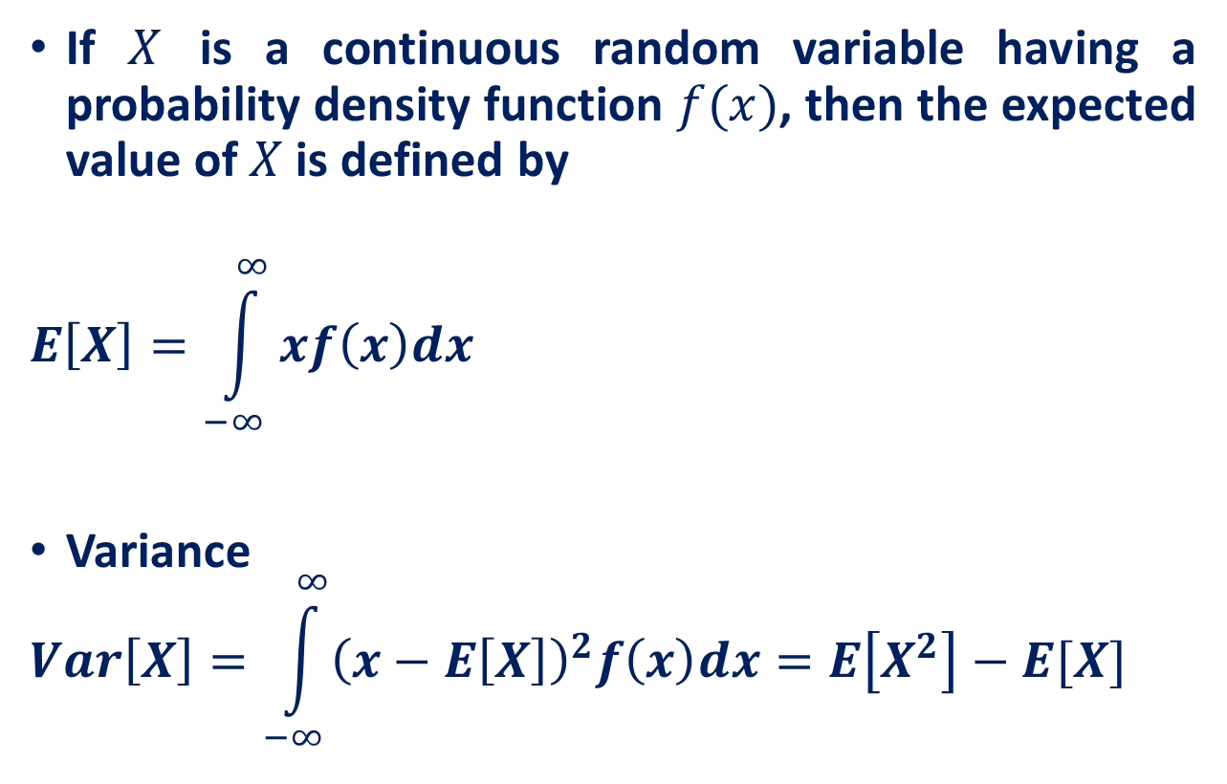
Continuous Random
If $X$ is a continuous random variable having a probability density function $f(x)$, then the expected value of $X$is defined by
$$E\left[X\right]=\int_{−∞}^{∞}{xf\left(x\right)dx}$$
Variance
$$Var\left[X\right]=\int_{−∞}^{∞}{{\left(x−E\left[X\right]\right)}^{2}f\left(x\right)dx=E\left[X^{2}\right]−E[X]}$$

Slide 26
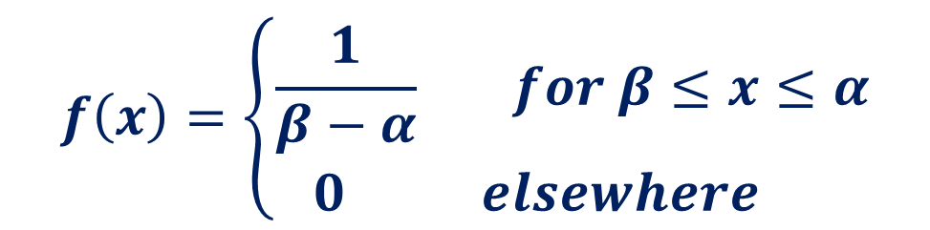
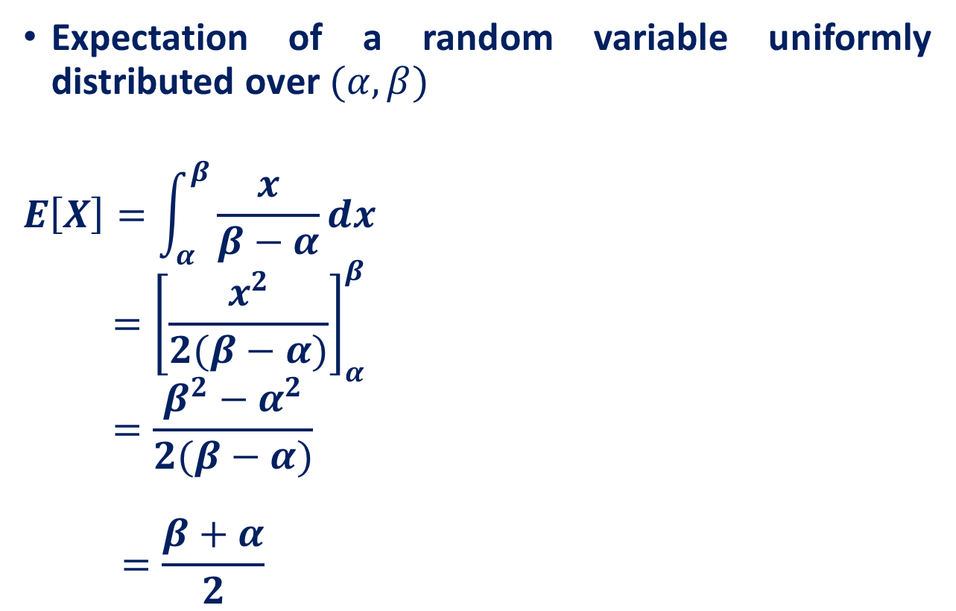
Recall: Uniform Random Variable
Expectation of a random variable uniformly distributed over $(α, β)$
$$E\left[X\right]=\int_{α}^{β}{\frac{x}{β−α}dx}$$
$${ =\left[\frac{x^{2}}{2(β−α)}\right]}_{α}^{β}$$
$$=\frac{β^{2}−α^{2}}{2(β−α)}$$
$$=\frac{β+α}{2}$$
$$f\left(x\right)=\left\{\begin{aligned}\frac{1}{β−α} for β≤x≤α \\ 0 elsewhere \end{aligned}\right.$$

Slide 27
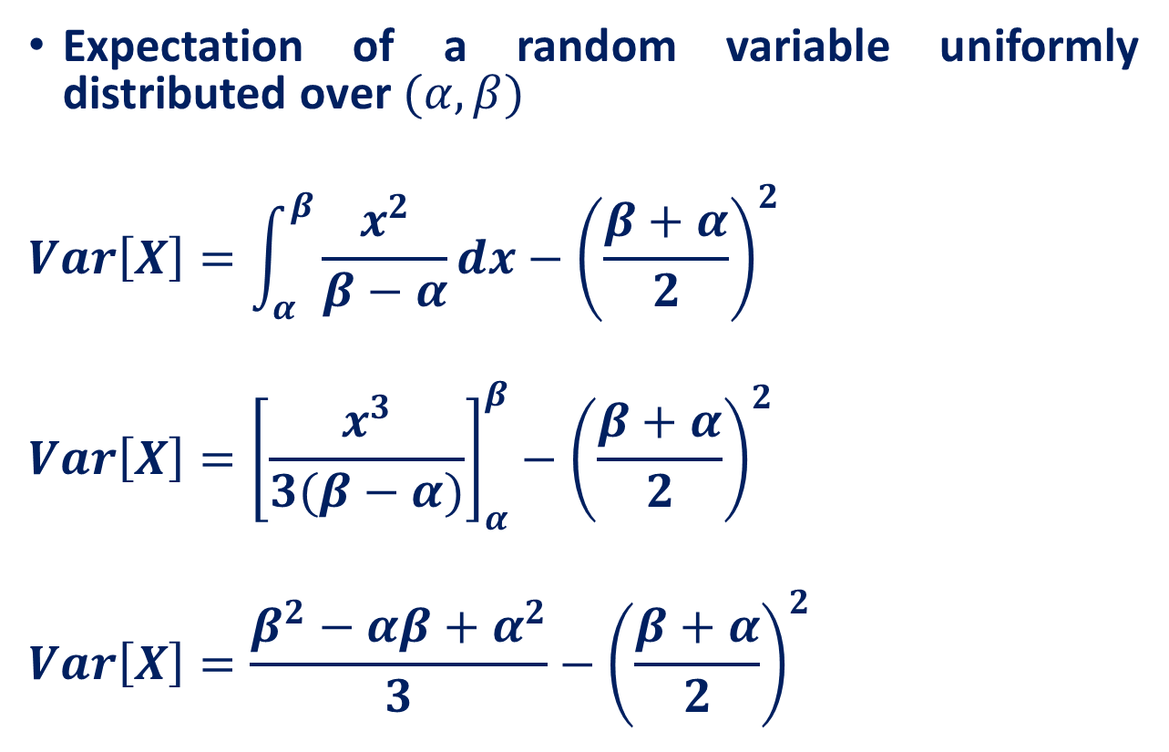
Recall: Uniform Random Variable
Expectation of a random variable uniformly distributed over $(α, β)$
$$Var\left[X\right]=\int_{α}^{β}{\frac{x^{2}}{β−α}dx}−{\left(\frac{β+α}{2}\right)}^{2}$$
$${Var\left[X\right]=\left[\frac{x^{3}}{3(β−α)}\right]}_{α}^{β}−{\left(\frac{β+α}{2}\right)}^{2}$$
$$Var\left[X\right]=\frac{β^{2}−αβ+α^{2}}{3}−{\left(\frac{β+α}{2}\right)}^{2}$$

Slide 28
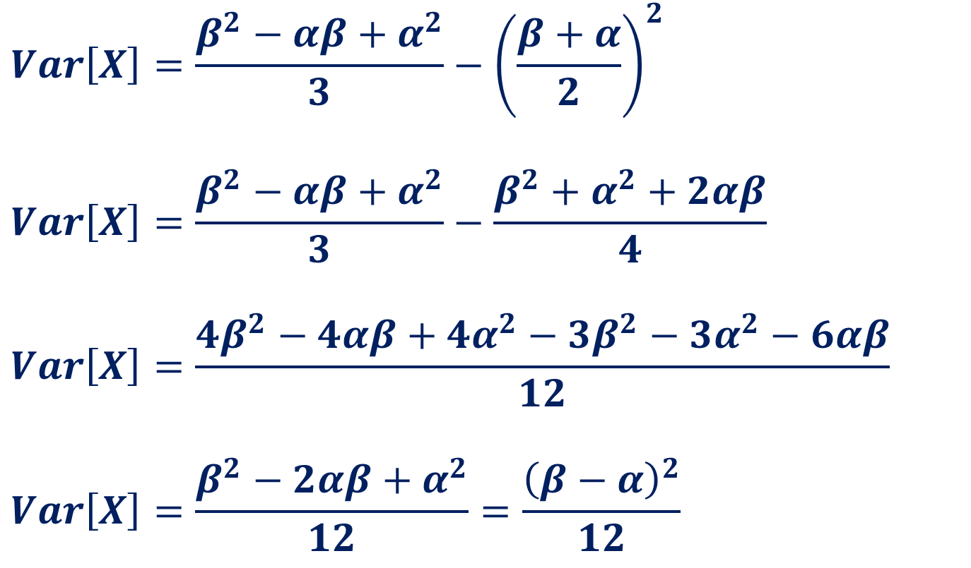
Recall: Uniform Random Variable
$$Var\left[X\right]=\frac{β^{2}−αβ+α^{2}}{3}−{\left(\frac{β+α}{2}\right)}^{2}$$
$$Var\left[X\right]=\frac{β^{2}−αβ+α^{2}}{3}−\frac{β^{2}+α^{2}+2αβ}{4}$$
$$Var\left[X\right]=\frac{{4β}^{2}−4αβ+{4α}^{2}−{3β}^{2}−3α^{2}−6αβ}{12}$$
$$Var\left[X\right]=\frac{β^{2}−2αβ+α^{2}}{12}=\frac{{\left(β−α\right)}^{2}}{12}$$

Slide 29
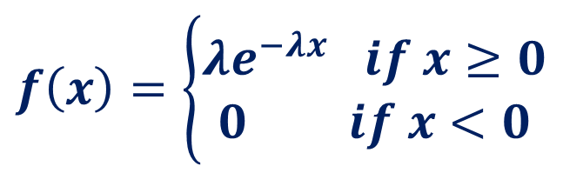
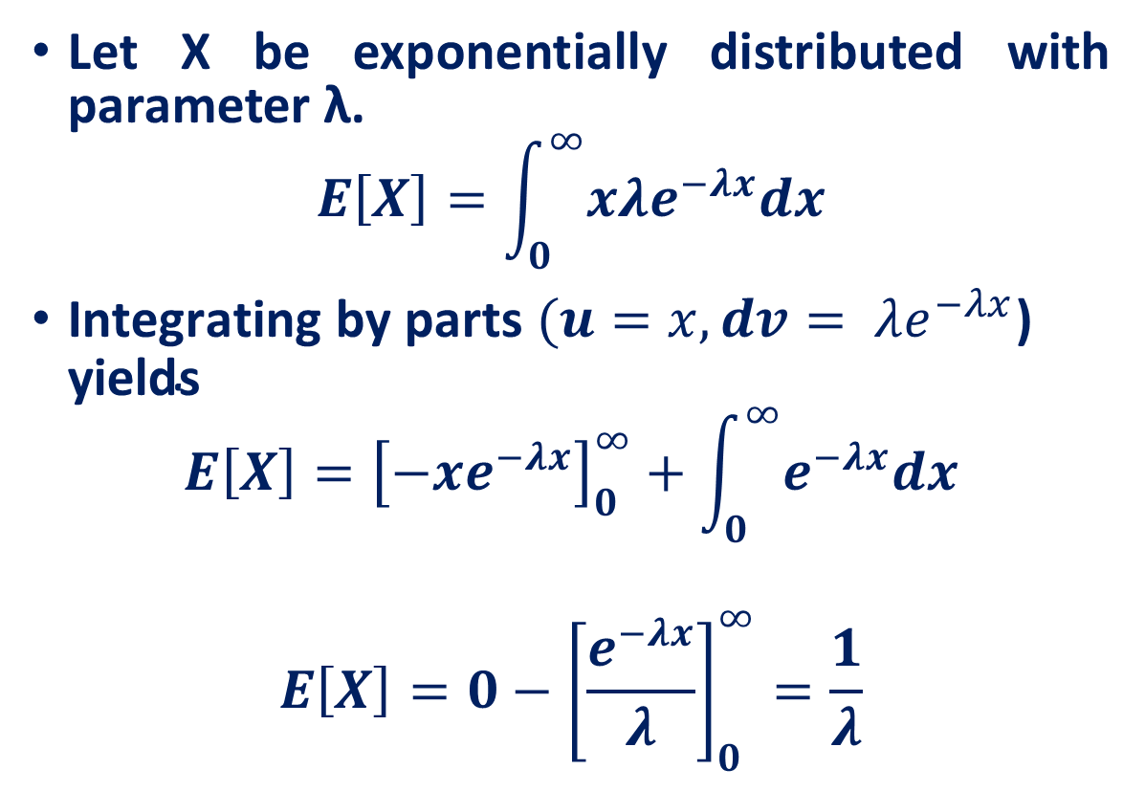

Recall: Exponential Random Variable
Let X be exponentially distributed with parameter λ.
$$E\left[X\right]=\int_{0}^{∞}{x{λe}^{−λx}dx}$$
$\text{Integrating} \text{by} \text{parts} (u=x,dv= λe^{−λx}\text{)} \text{yields}$
$$E\left[X\right]={\left[−xe^{−λx}\right]}_{0}^{∞}+\int_{0}^{∞}{e^{−λx}dx}$$
$$E\left[X\right]=0−{\left[\frac{e^{−λx}}{λ}\right]}_{0}^{∞}=\frac{1}{λ}$$
$$f\left(x\right)=\left\{\begin{aligned}λe^{−λx} if x≥0 \\ 0 if x<0\end{aligned}\right.$$
$$Var[X]=\frac{1}{λ^{2}}$$

Slide 30
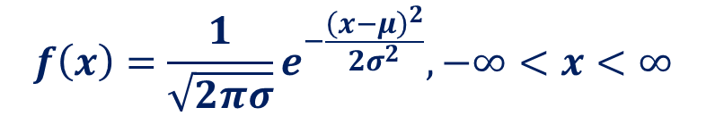
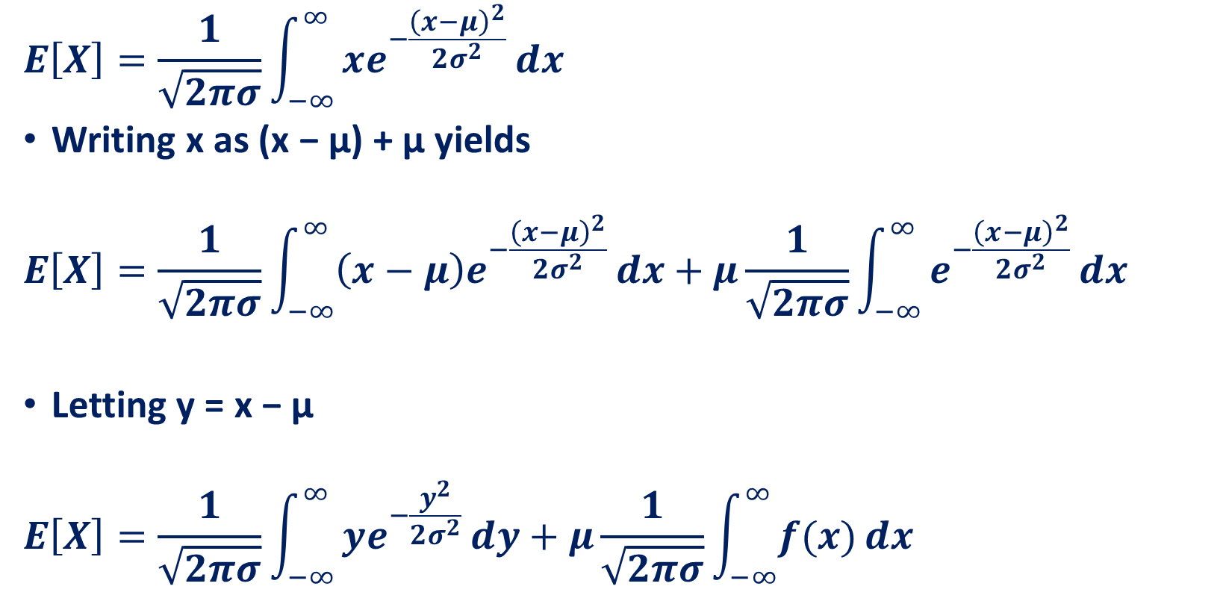
Recall: Normal Random Variable
$$f\left(x\right)=\frac{1}{\sqrt{2πσ}}e^{−\frac{{\left(x−μ\right)}^{2}}{2σ^{2}}}, −∞<x<∞$$
$$E\left[X\right]=\frac{1}{\sqrt{2πσ}}\int_{−∞}^{∞}{xe^{−\frac{{\left(x−μ\right)}^{2}}{2σ^{2}}}}dx$$
Writing x as (x − μ) + μ yields
$$E\left[X\right]=\frac{1}{\sqrt{2πσ}}\int_{−∞}^{∞}{\left(x−μ\right)e^{−\frac{{\left(x−μ\right)}^{2}}{2σ^{2}}}}dx+μ\frac{1}{\sqrt{2πσ}}\int_{−∞}^{∞}{e^{−\frac{{\left(x−μ\right)}^{2}}{2σ^{2}}}}dx$$
Letting y = x − μ
$$E\left[X\right]=\frac{1}{\sqrt{2πσ}}\int_{−∞}^{∞}{ye^{−\frac{y^{2}}{2σ^{2}}}}dy+μ\frac{1}{\sqrt{2πσ}}\int_{−∞}^{∞}{f(x)}dx$$

Slide 31


Recall: Normal Random Variable
$$E\left[X\right]=\frac{1}{\sqrt{2πσ}}\int_{−∞}^{∞}{ye^{−\frac{y^{2}}{2σ^{2}}}}dy+μ\frac{1}{\sqrt{2πσ}}\int_{−∞}^{∞}{f(x)}dx$$
$$E\left[X\right]=0+μ\frac{1}{\sqrt{2πσ}}\int_{−∞}^{∞}{f(x)}dx=μ$$
$$Var\left[X\right]=σ^{2}$$

Slide 32
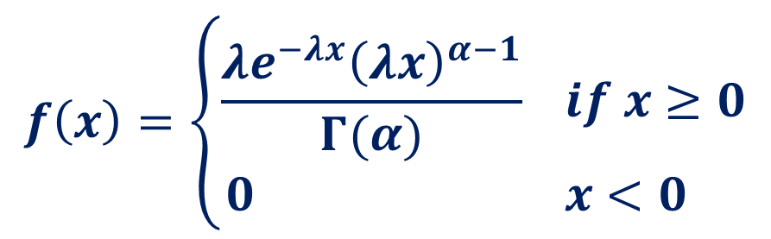

Recall: Gamma Random Variable
$E\left[X\right]=\frac{α}{λ}$
$Var\left[X\right]=\frac{α}{λ^{2}}$
$$f\left(x\right)=\left\{\begin{aligned}\frac{λe^{−λx}{\left(λx\right)}^{α−1}}{Γ(α)} if x≥0 \\ 0 x<0 \end{aligned}\right.$$

Slide 33
Reference
Lecture notes on Probability Theory by Phanuel Mariano
Introduction to Probability Models, Sheldon M. Ross, Tenth Edition

